Slide 1


Administration of E-Placement system
INSTITUTE FOR ADVANCED COMPUTING AND SOFTWARE DEVELOPMENT(IACSD),AKURDI.
Presented by-
Gaurav Vijay Patil (1025)
Girish Dilip Dhande (1026)
Mr. Prashant Karhale
Centre Coordinator
Mr. Chetan Pardeshi
Project Guide

Slide 2
INDEX
Introduction
Motivation
Existing System
Proposed System
Objectives
System Architecture
Description of system
Applications
Advantages and Disadvantages
Screenshots
Future scope
Conclusion
References

Slide 3
Introduction
The purpose of the project “ADMINISTRATION OF E-PLACEMENT SYSTEM”, the manual work makes the process slow and other problems such as inconsistency and ambiguity on operations. In order to avoid this, web based placement managed system is proposed, where the student information in the college with regard to placement is managed efficiently. The key feature of this project is that it is one-time registration enabled. The placement cell calls the companies to select their students for jobs via the campus interview. The placement cell allows the companies to view the student resumes in selective manner. Our project provides the facility of maintaining the details of the students and gets the requested list of candidates for the company who would like to recruit the students based on given query. They can filter the students profile as per their requirement. The job details of the placed students will be provided by the training and placement officer.

Slide 4
Motivation
Easy to Access things & save time .
TPO will allow quick and easy management of online placement which can manage all students easily.
To help fast in fast access procedures in placement related activities and ensures to maintain the details of the student.

Slide 5
Existing System
The existing system describes the features of the previous working model and their drawback. Existing system does all process manually. Placement officers register the information of students. If any modifications or updates are required in the profile of any student, it has to be done manually. This is tedious and time consuming, lack of security of data, took more man power, consumes large volume of paper and space. This process is so difficult when number of user’s increases.

Slide 6
PROPOSED System
The aim of the proposed system is to develop a system with improved facilities. The proposed system can overcome all the limitation of the existing system, such as student’s information is maintained in the database, it gives more security to data, ensures data accuracy, reduces paper work and save time, only eligible students get chance, it makes information flow efficient and paves way for easy report generation, reduce the space. proposed system is cost effective.

Slide 7
Objectives
The primary objective of the Software for Training and Placement System is to reduce the work load of the TPO’s who has to maintain all the records in a written format which becomes difficult to search and maintain which is very time consuming as well as very hectic.
Our project provides the facility of maintaining the details of the students and gets the requested list of candidates for the companies who would like to recruit the students based on given query.

Slide 8
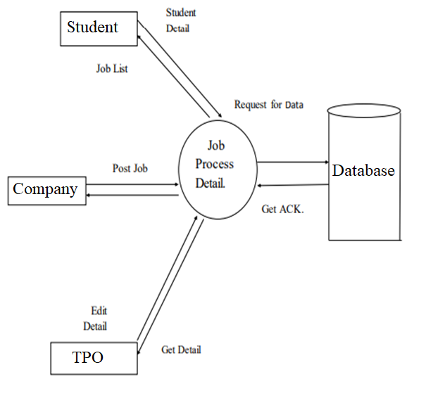
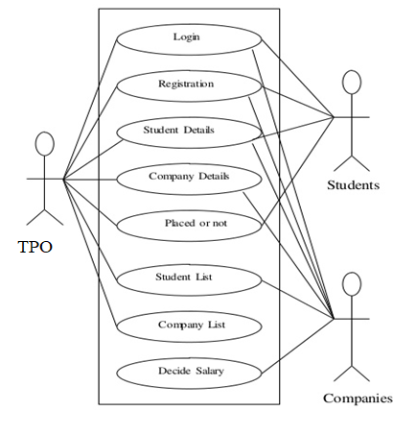
System Architecture & USE CASE DIAGRAM

Slide 9
Description of the system
Registration if user wants to login then he/she must be registered, Unregistered user cannot get login. Login user logins to the system by entering valid user id and password for going to welcome page.
After login, user will be identified if user is Training and Placement Officers (TPO) then he/she can see the student list and can filter it as per requirement, also Training and Placement Officers (TPO) can add company information on portal and notification can be send eligible student list. If login user is student then he/she can edit the information of his/her profile and can see notification of company to which he/she is eligible.
And if login user is recruiter then they can add recruitment notification by all their requirement.

Slide 10
Applications
This system will serve as an web application for efficient planning of the placement without any hassle.
No need to physically visit any places especially in the pandemic.

Slide 11
Advantages & Disadvantages
Advantages-
It is user- friendly.
Greater Efficiency.
Disadvantage-
Cannot work without internet connection.

Slide 12
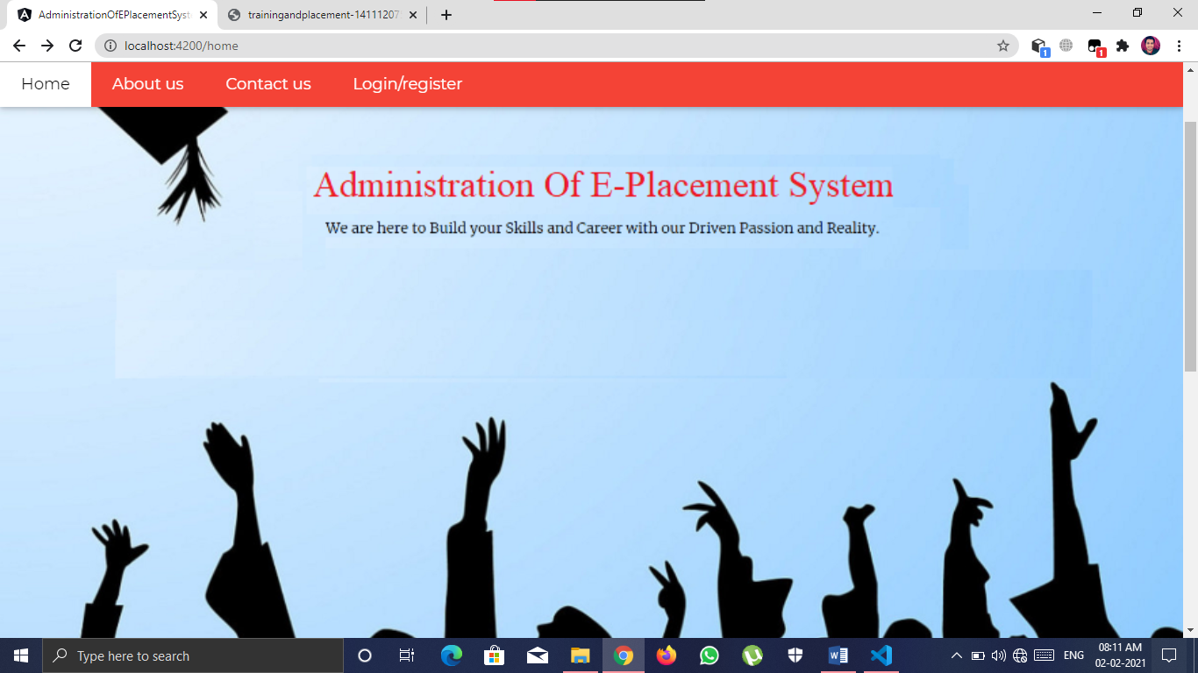
Screenshots-
Homepage

Slide 13
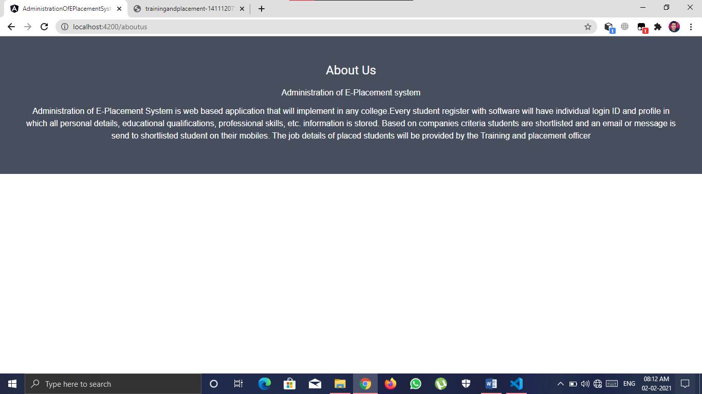
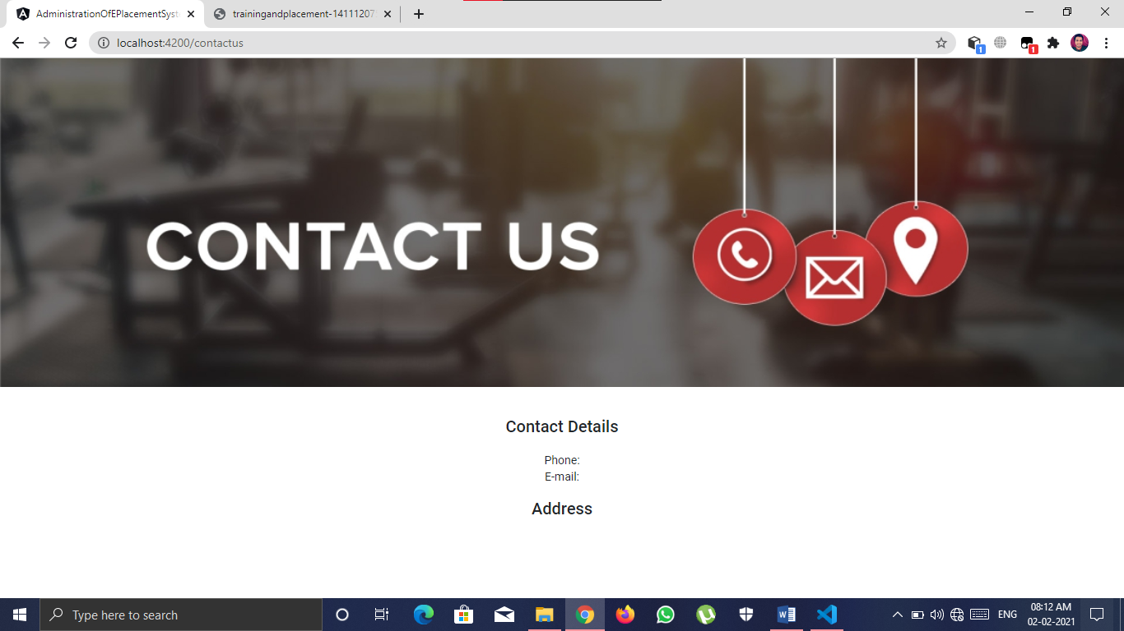
ABOUT US AND CONTACT US

Slide 14
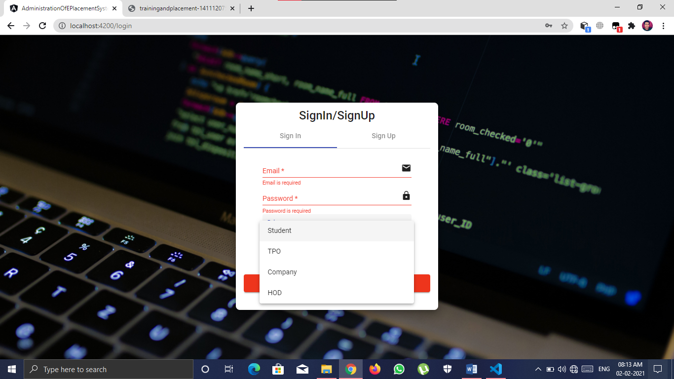
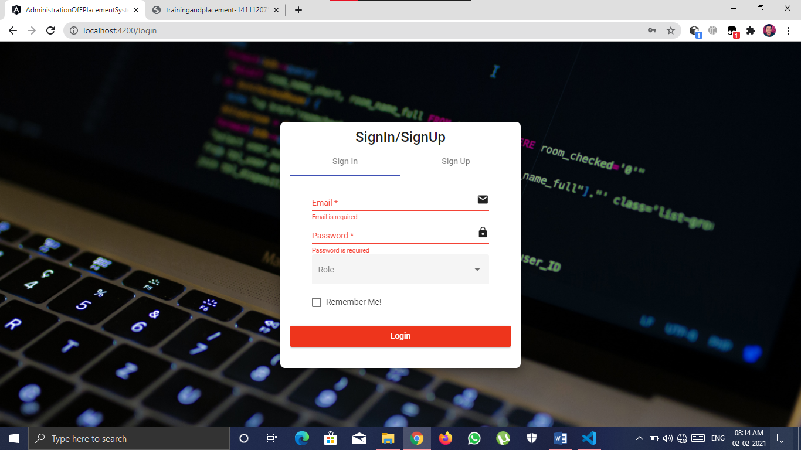
ROLE BASED LOGIN WITH VALIDATION

Slide 15
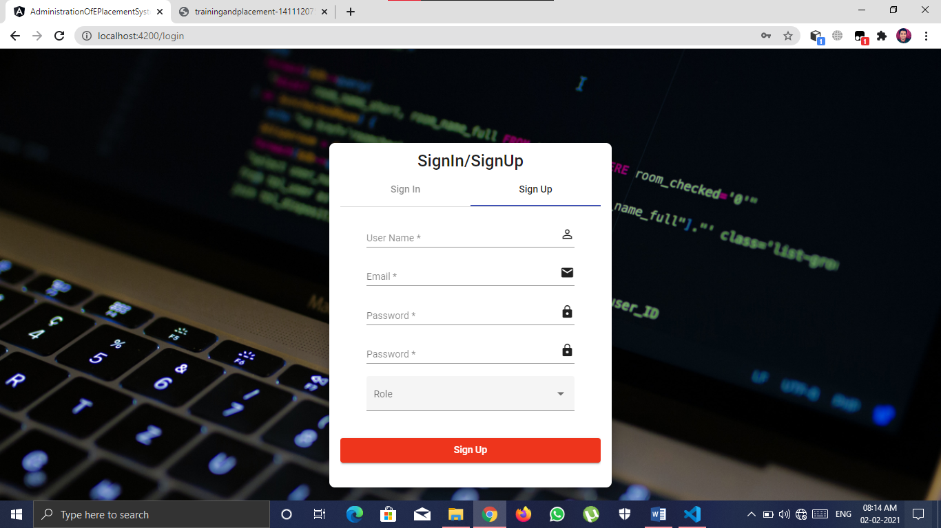
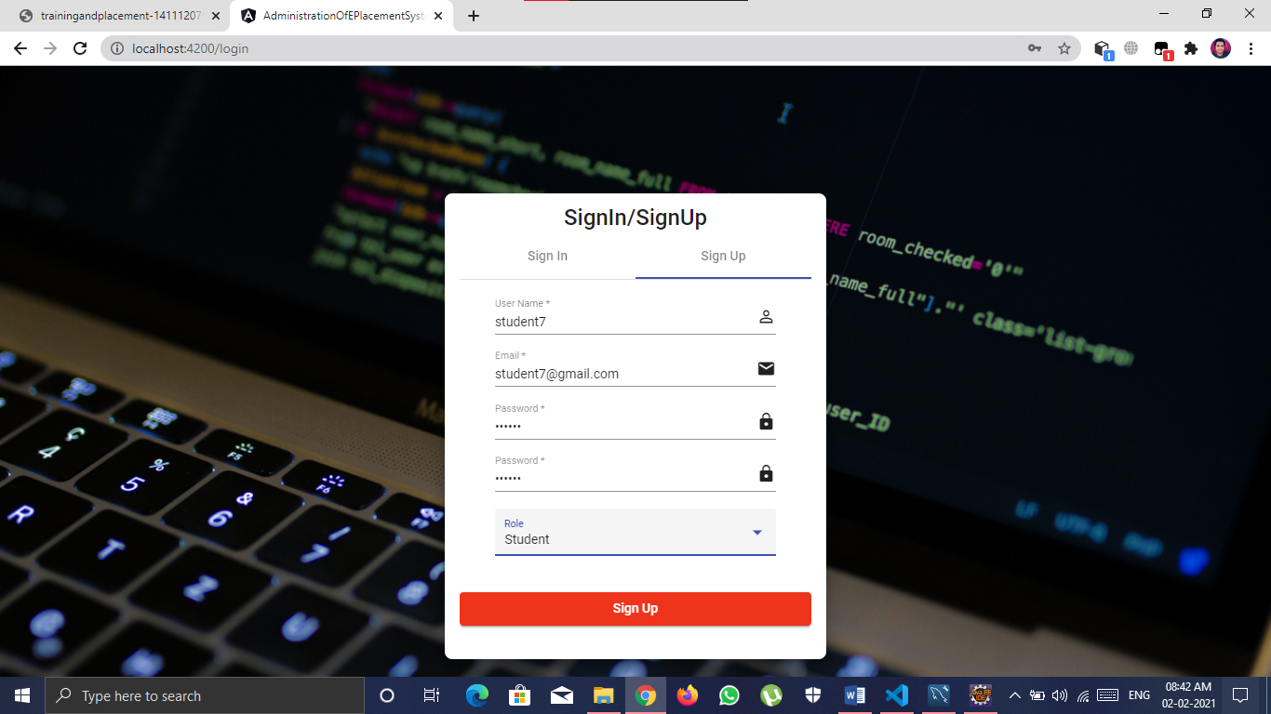
NEW USER REGISTRATION AS PER ROLE

Slide 16
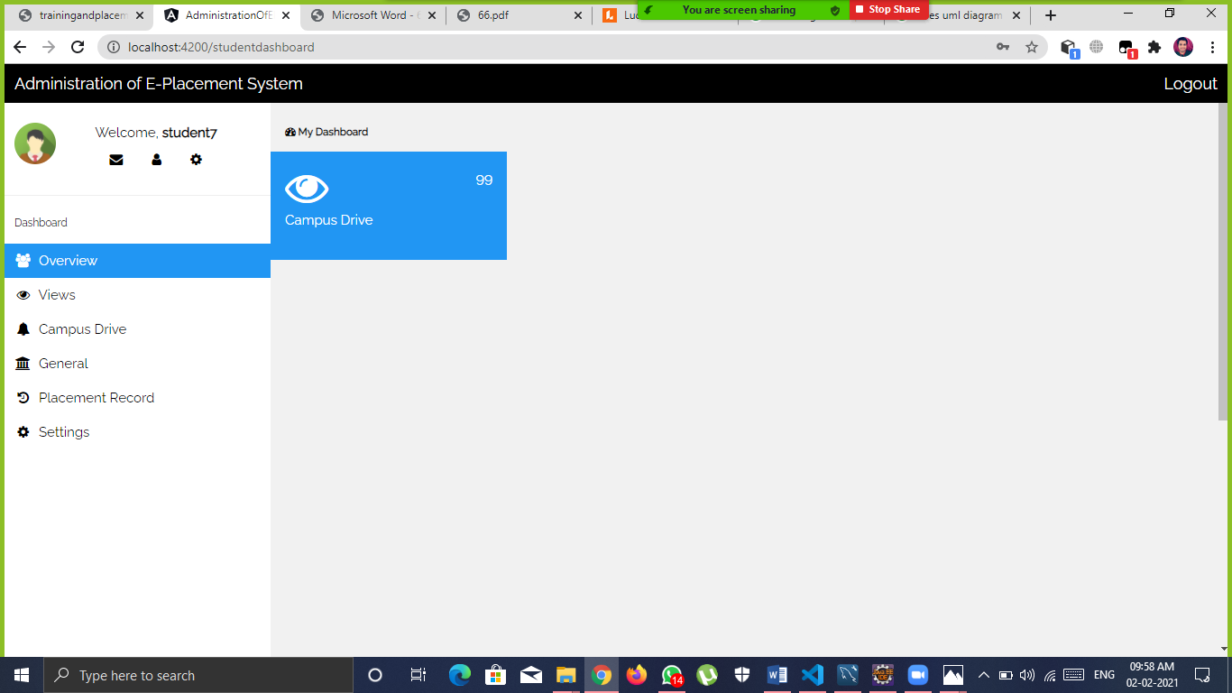
STUDENT LOGIN with dashboard

Slide 17
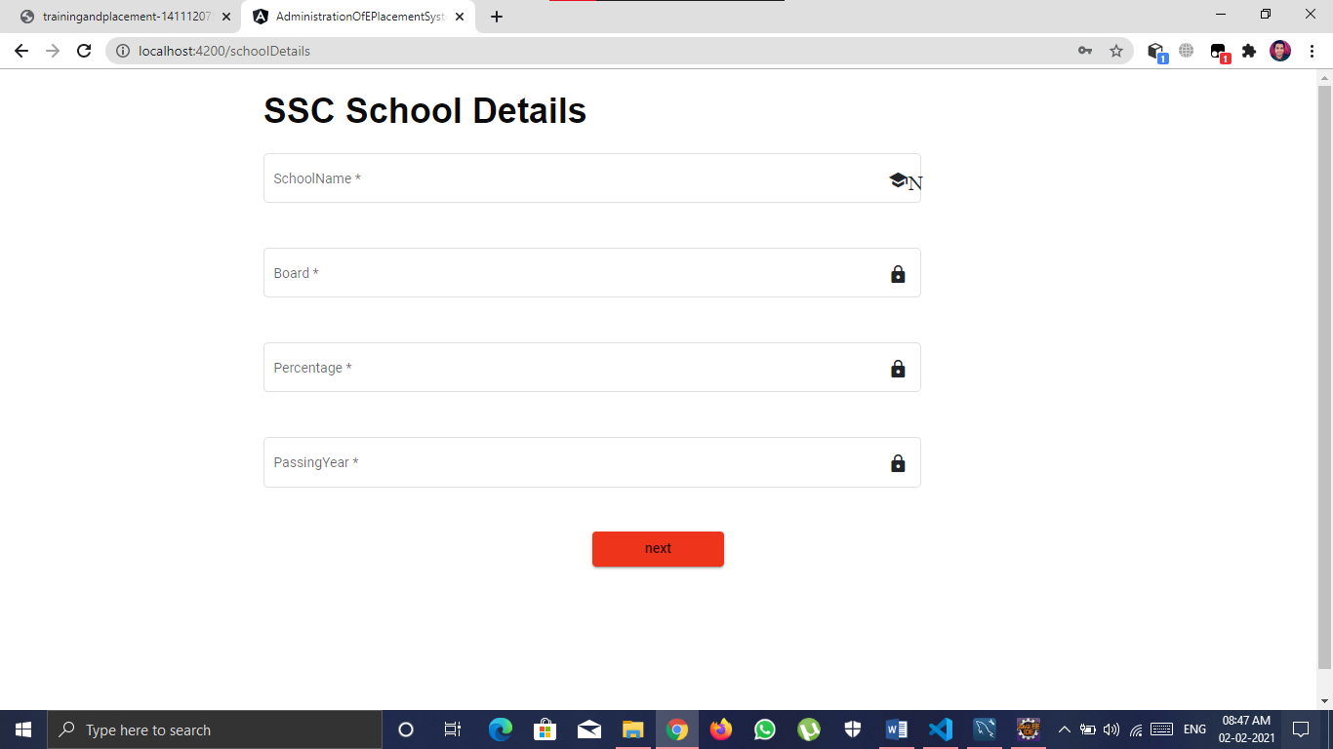

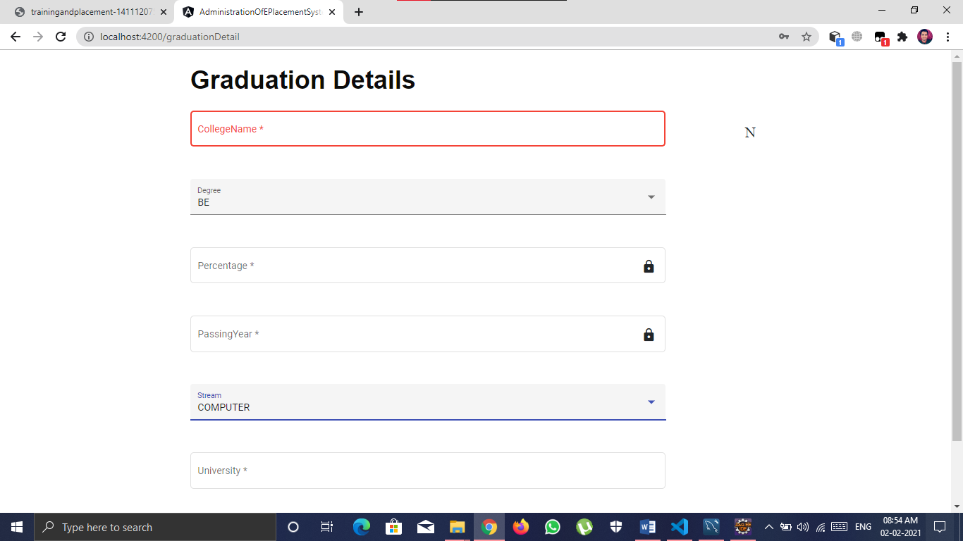
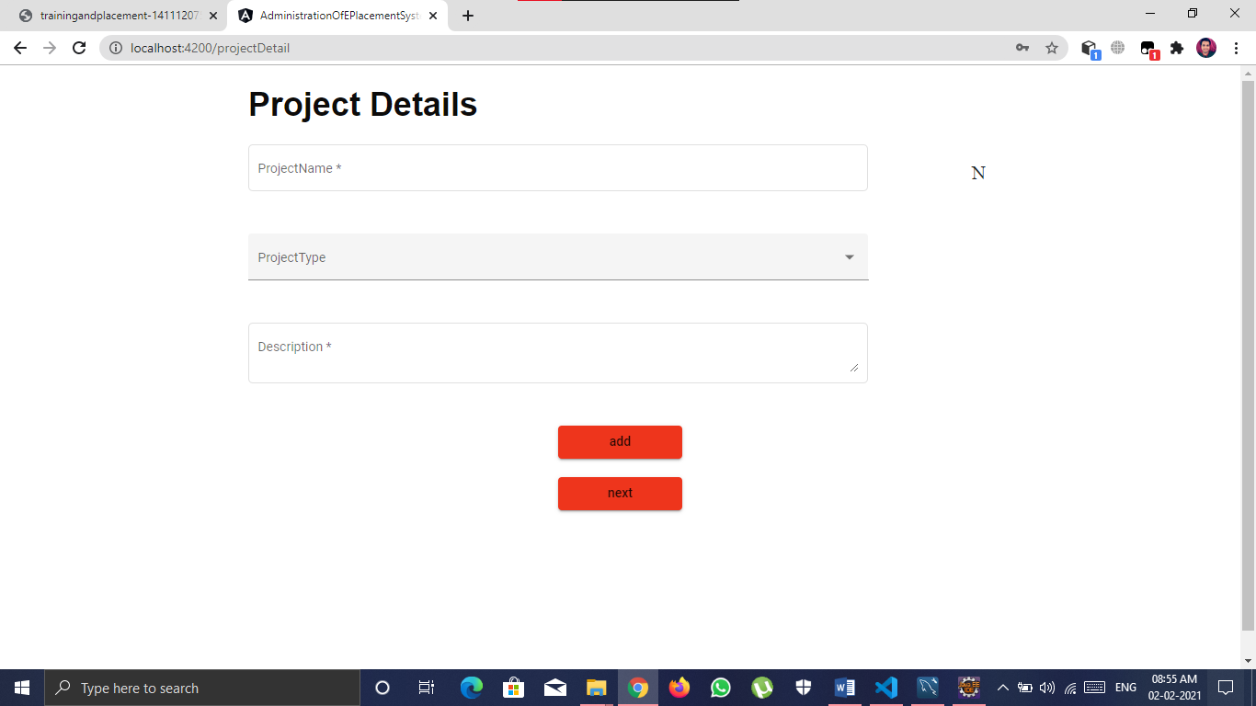
ONE EXAMPLE OS STUDENT REGISTRATION

Slide 18
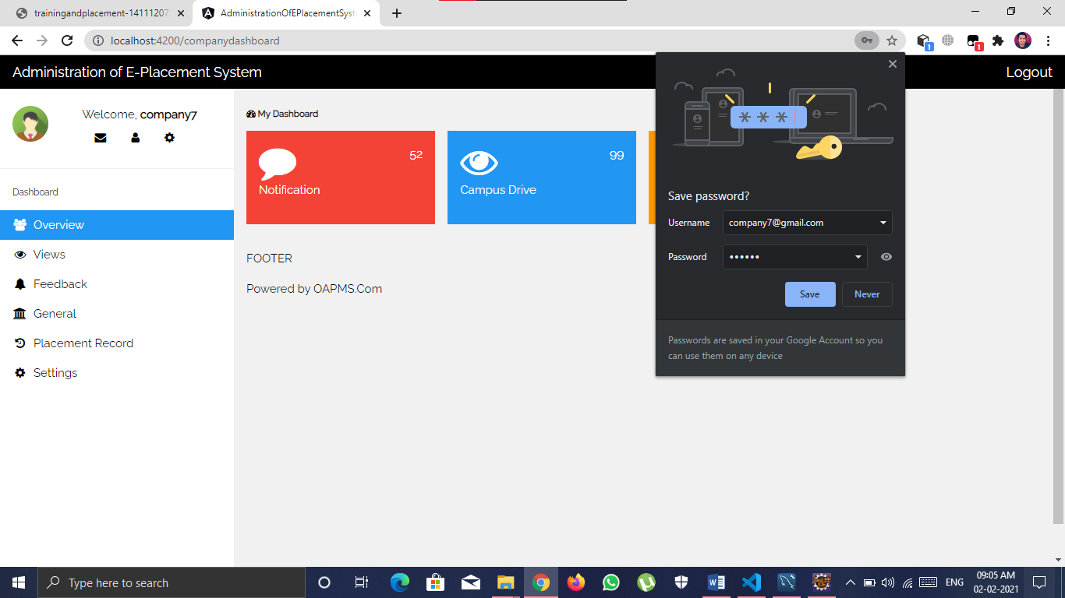
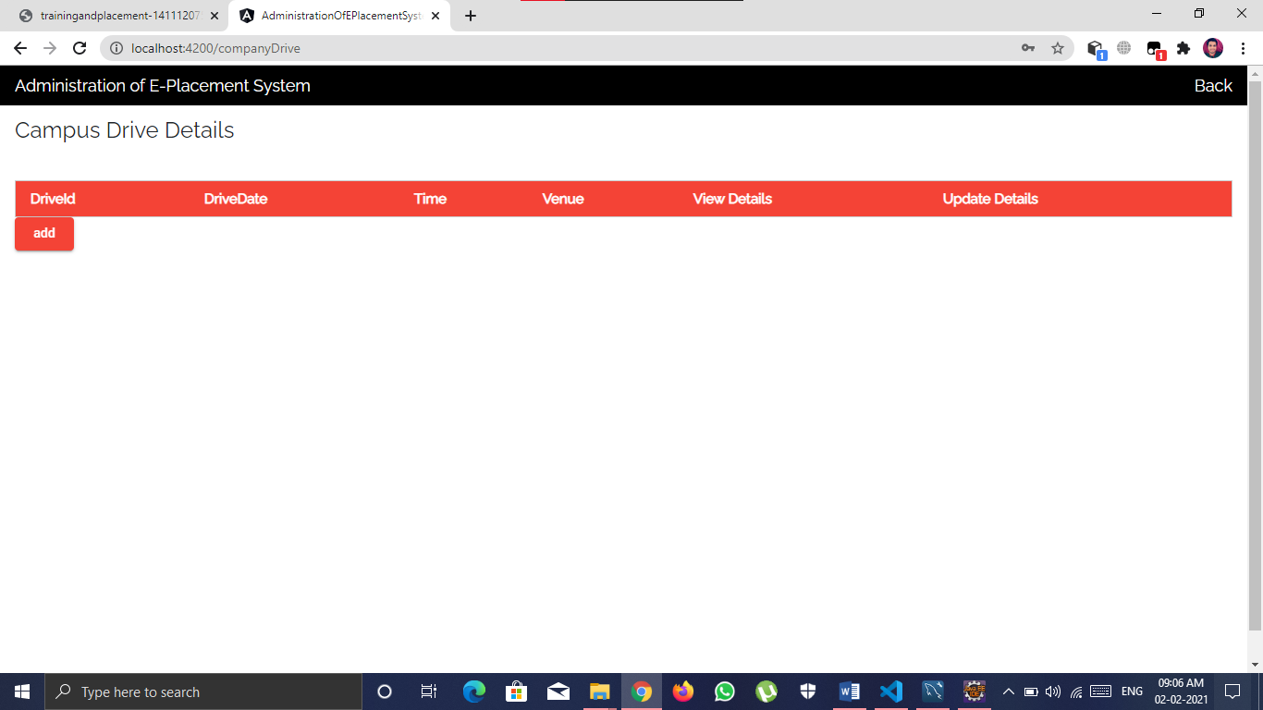
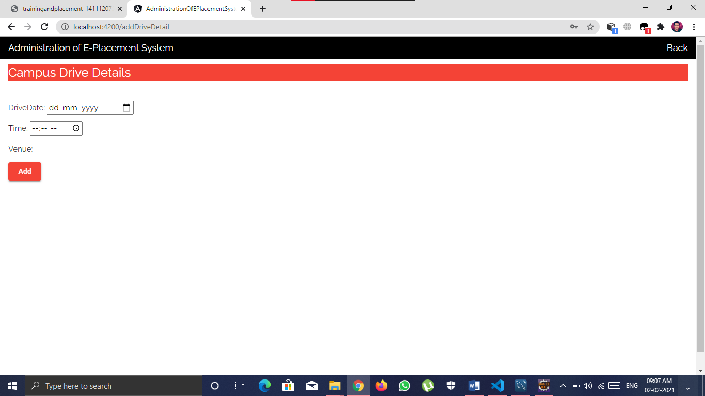
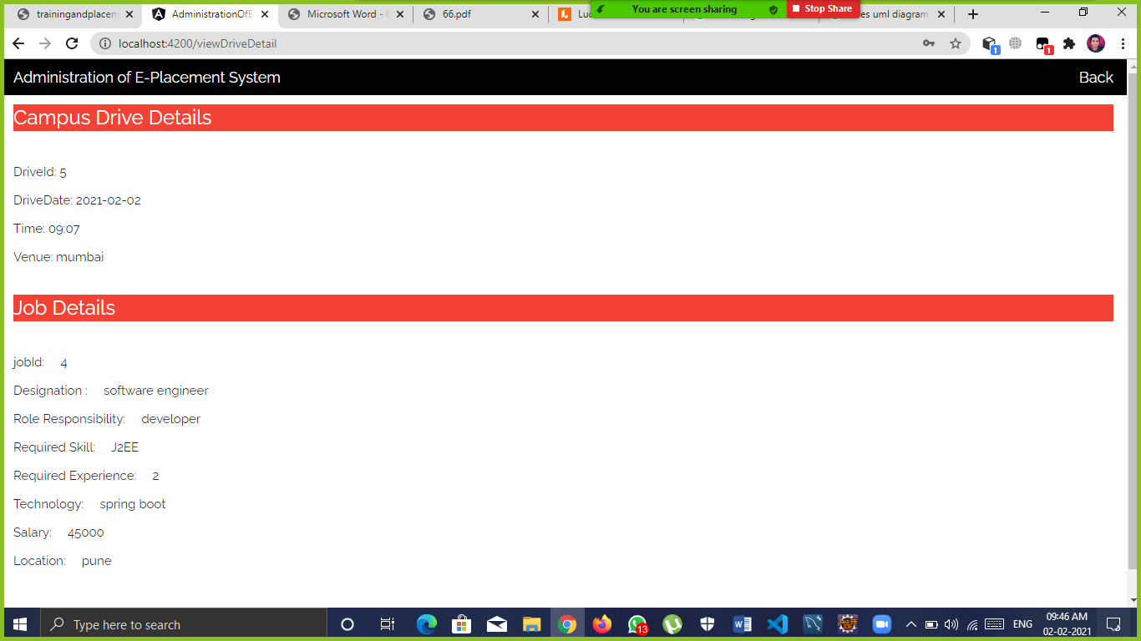
Company LOGIN

Slide 19
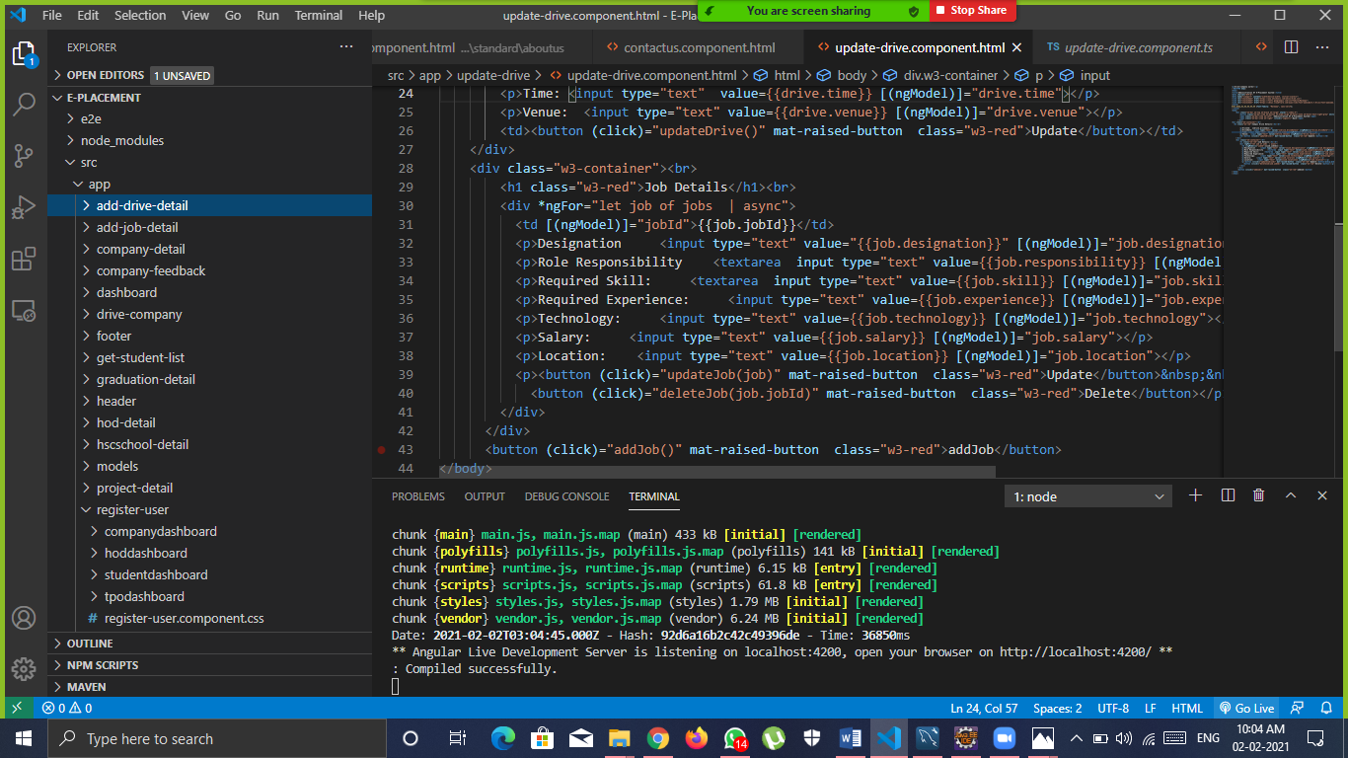
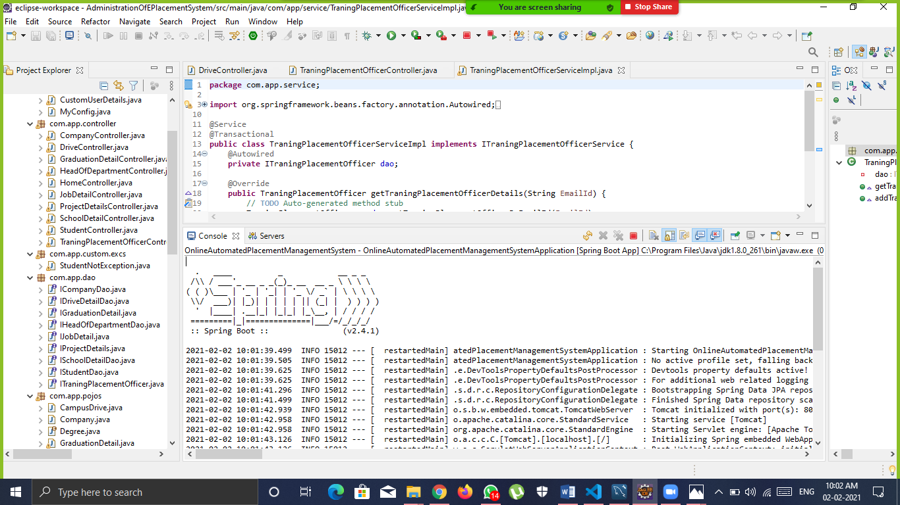
Frontend and backend

Slide 20
Future scope
Though our project is Itself matured enough but still betterment is always an open door. In this case also we can add some features to this software to make this software more reliable. These are as follows:
Firstly, during the development of the project my prime object was to keep the hardware & software requirement as minimum as possible so that it supports maximum user base.
Secondly, the searching procedure should be very strong like placement officer can search student as fast as possible.
Thirdly, modify the project with better approach with more graphics.

Slide 21
Conclusion
Comparing to existing computerized system, it performs at a faster pace.
System gives better feedback.
Accurate information is available.
Chances of such types of errors are much low.
Provides security to the system & software.
Forms are very user friendly
User can easily work in project
User can search for city wise company’s
Admin can decide for who company registered or not
User process for efficient in project
So at last we conclude that this Project will be useful to several Students to search for better jobs and Search for Companies according to their convenience to employer

Slide 22
References
Google for problem solving
Head First Java 2nd Edition
http://www.javatpoint.com/java-Latorial
http://www tutorialspoint.com/mysql/
https://www.w3schools.com/
https://www.geeksforgeeks.org/

Slide 23
Thank you!

